Slide 1
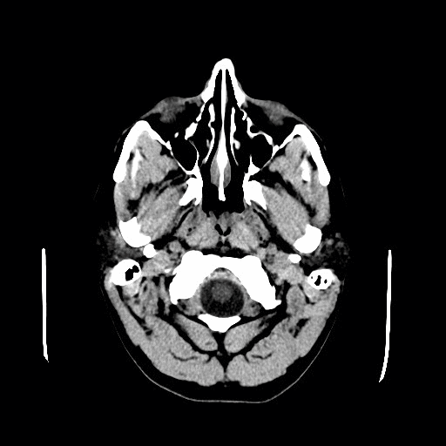
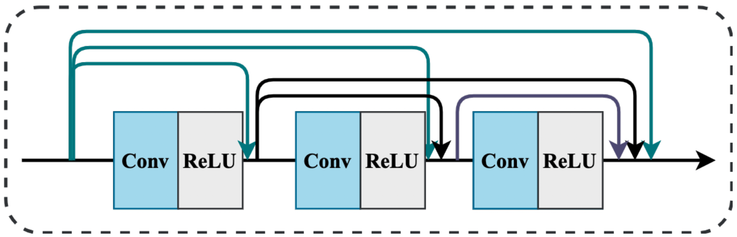
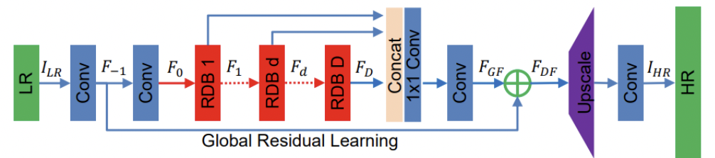
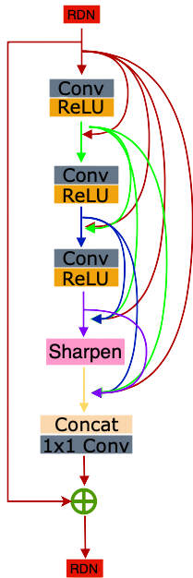
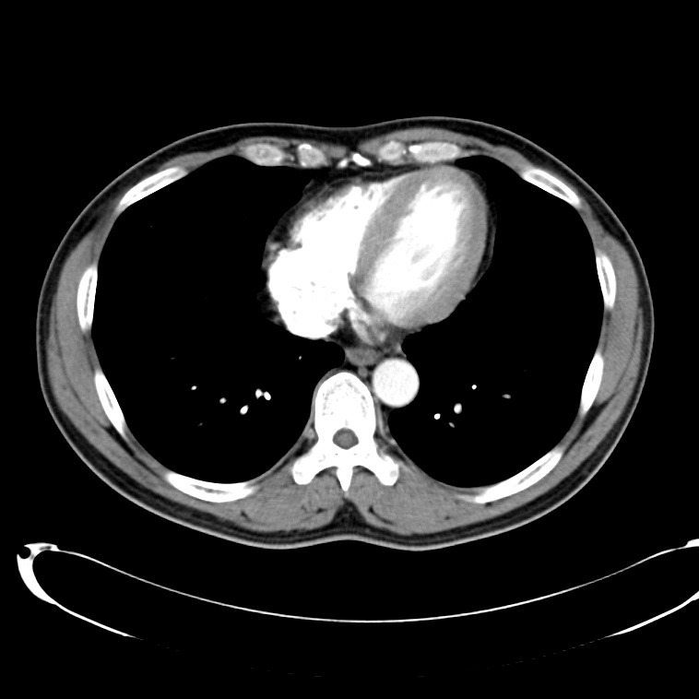
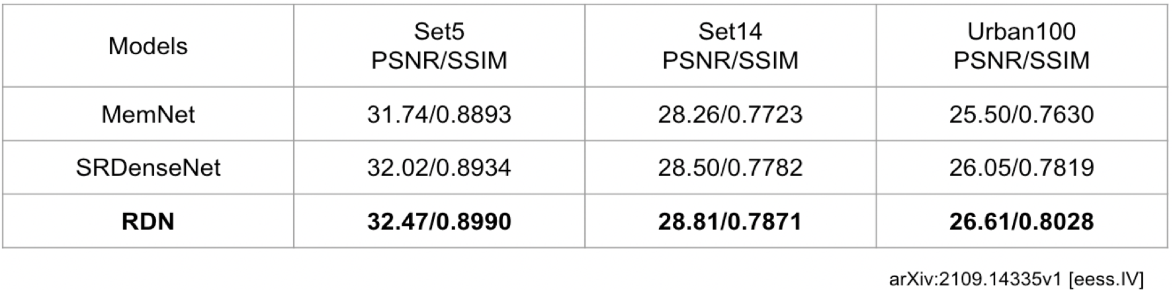
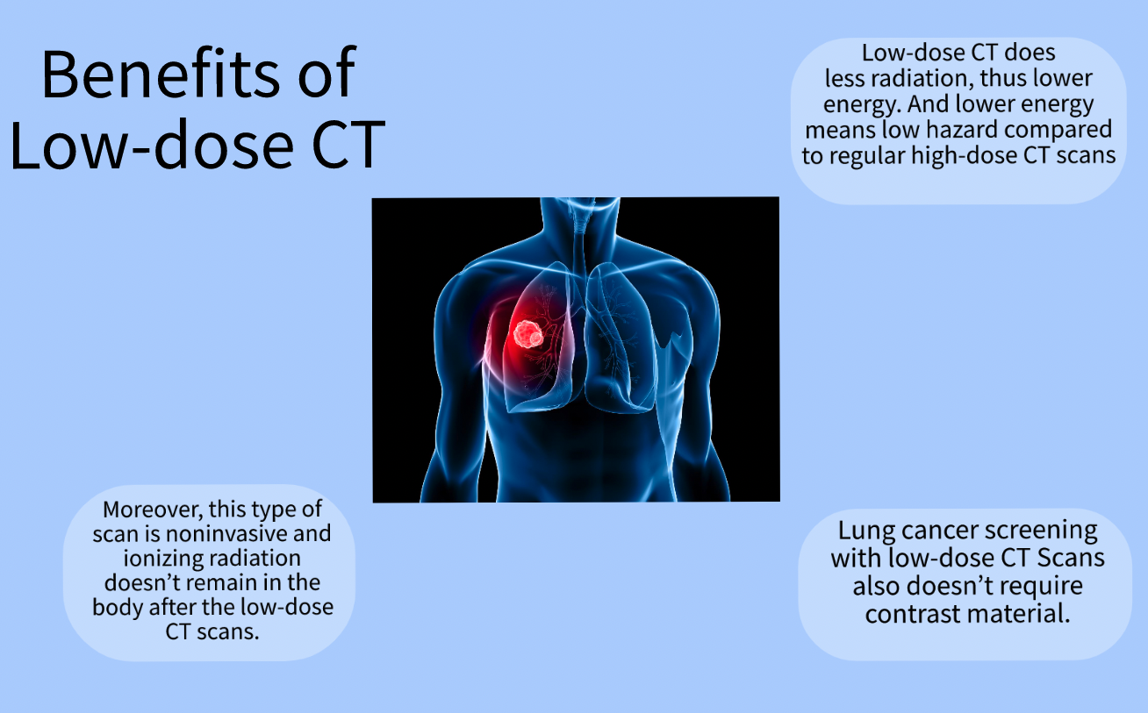
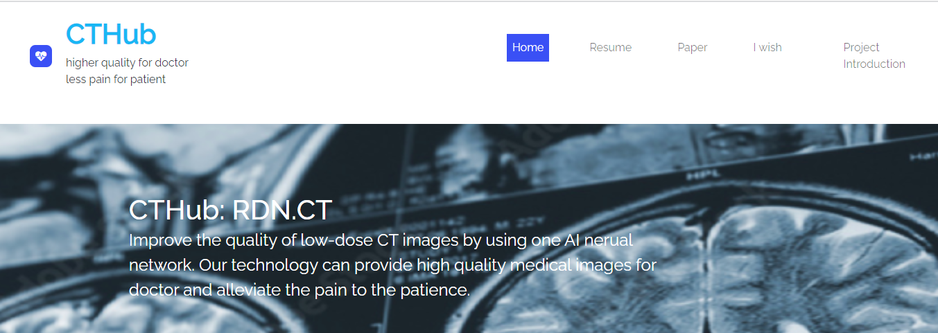
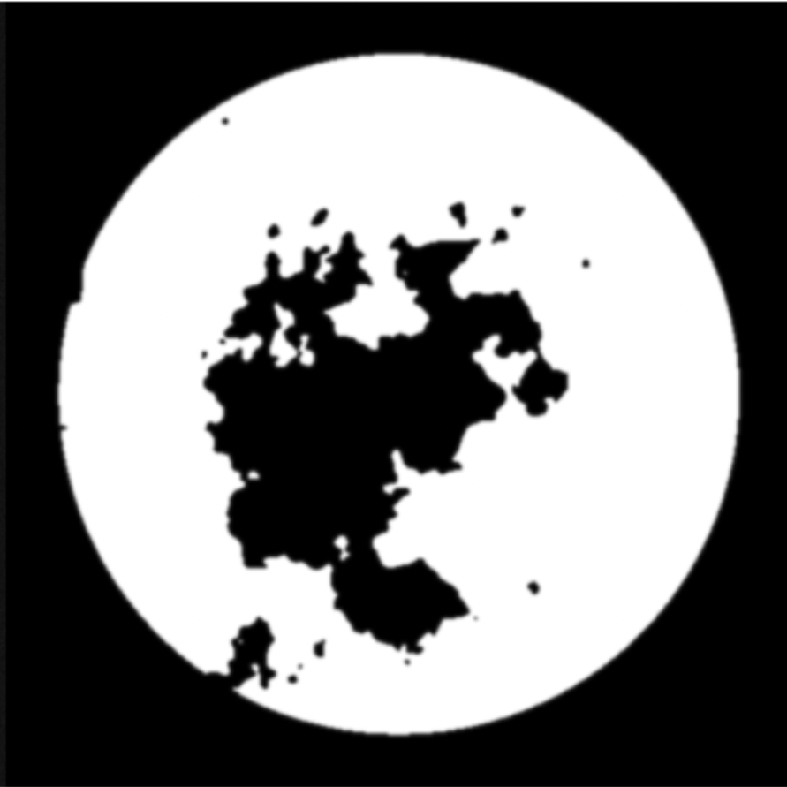

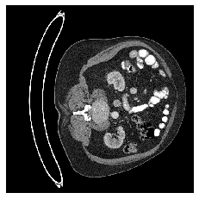
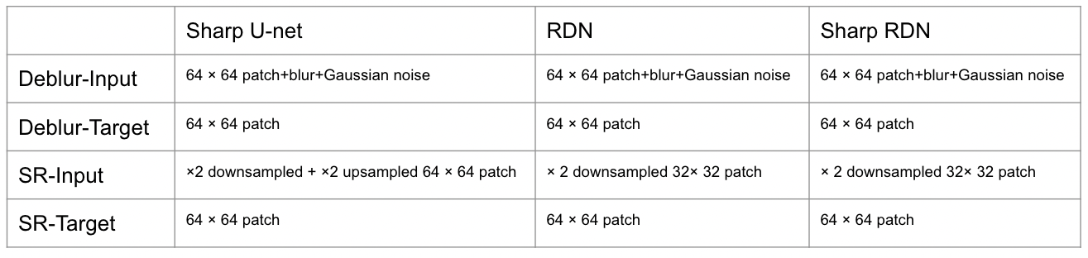
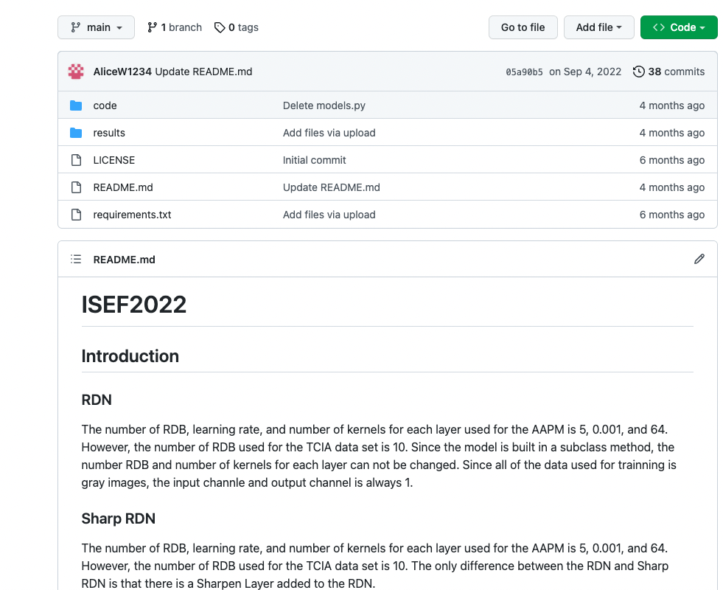
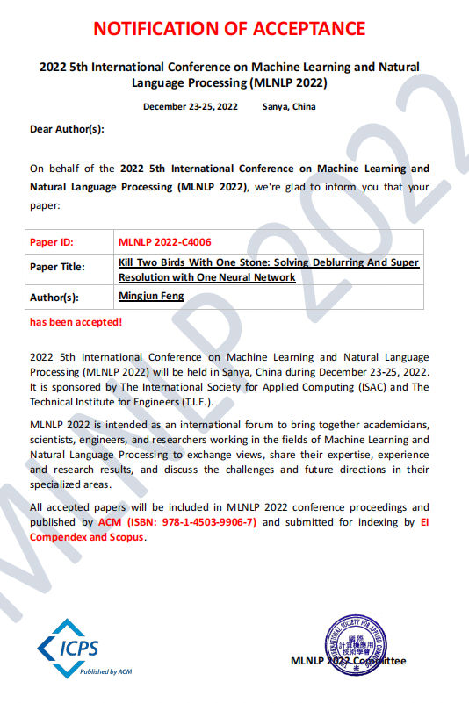
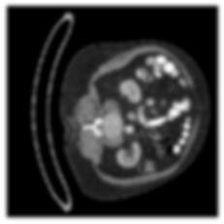
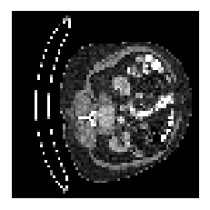
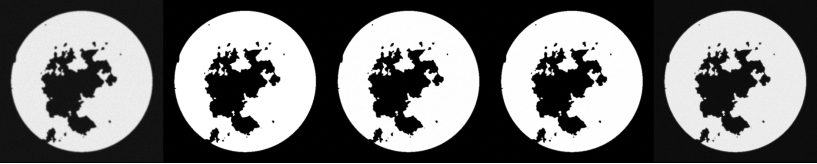
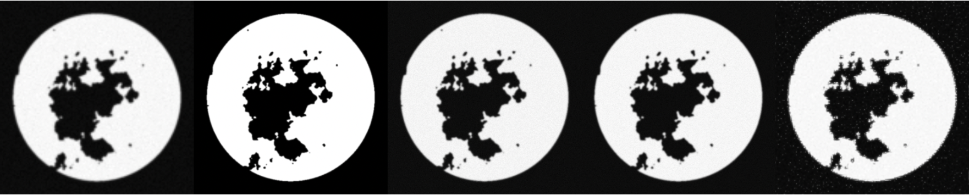
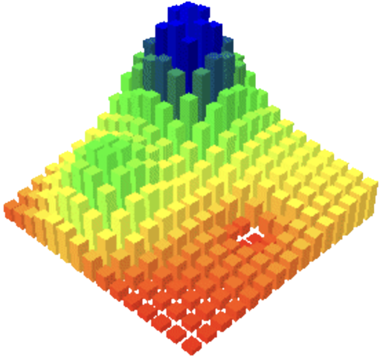
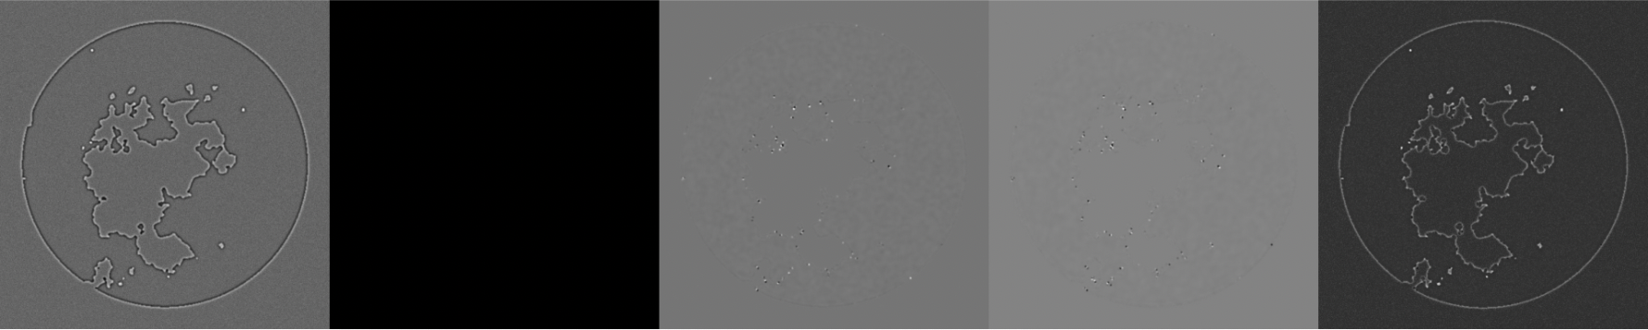
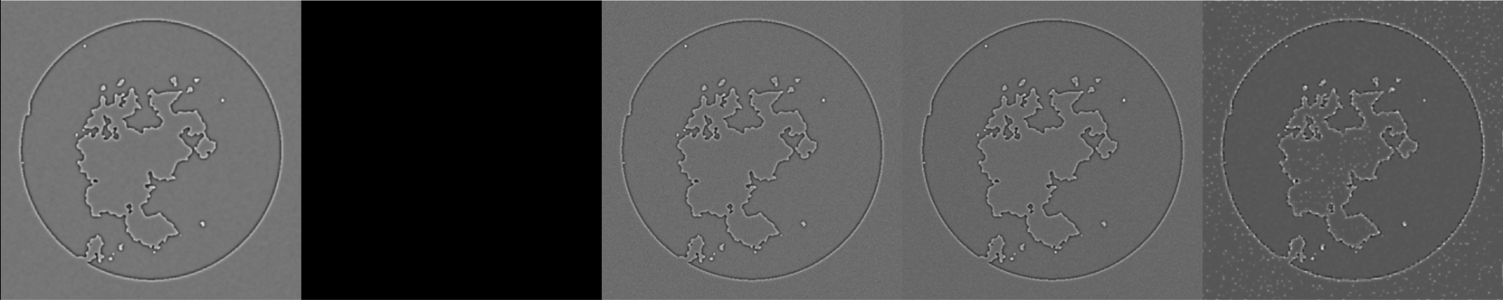
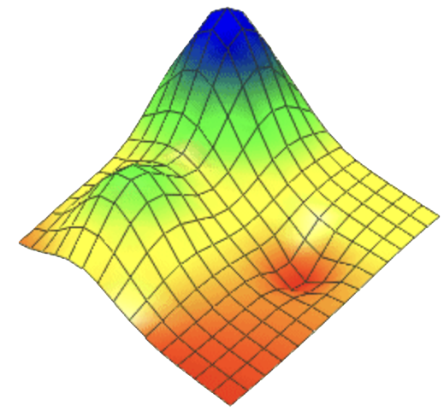
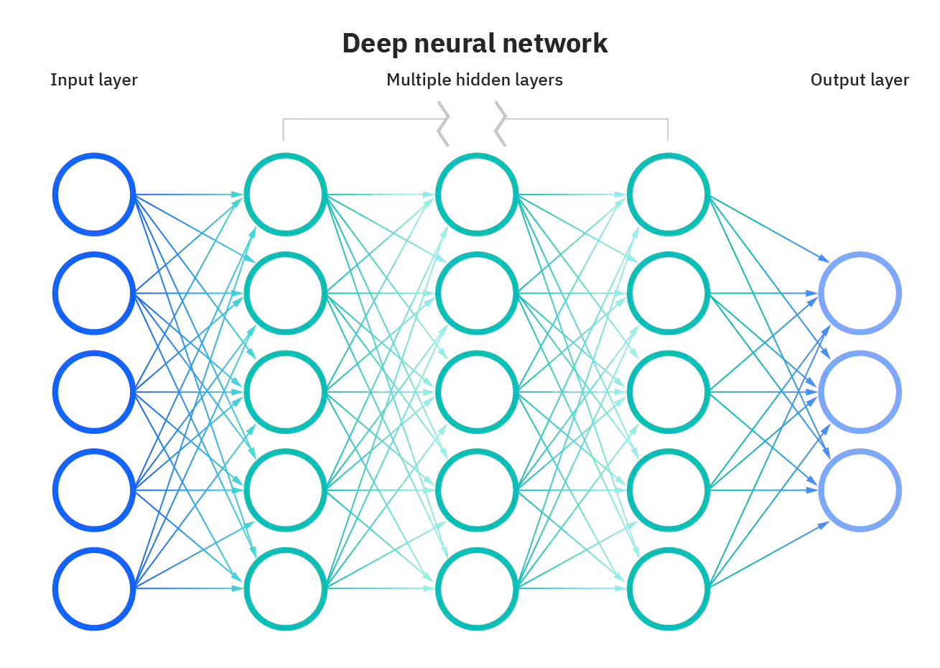
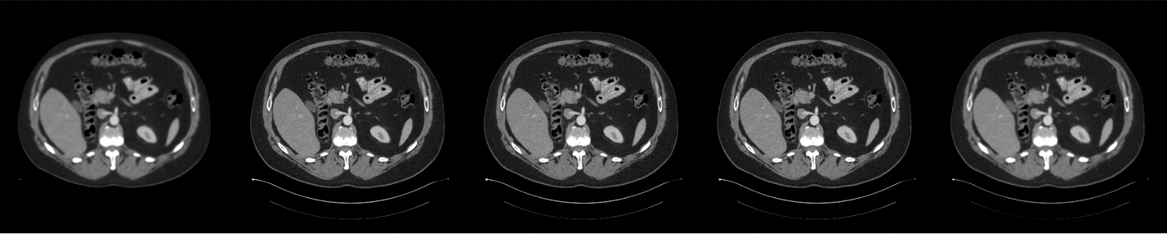
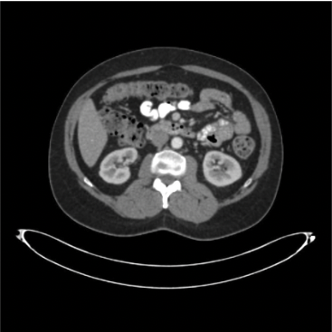
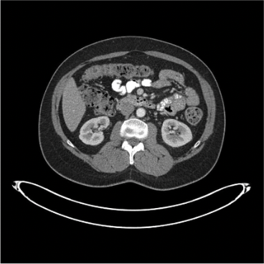
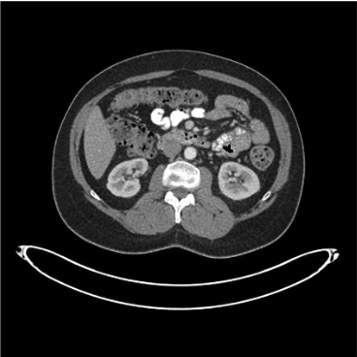
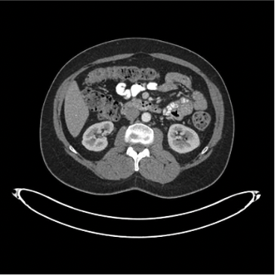
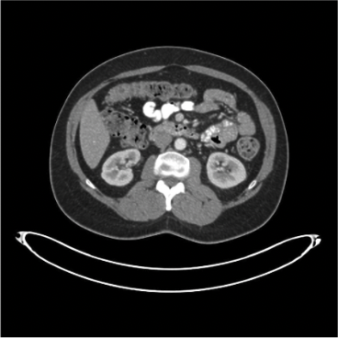
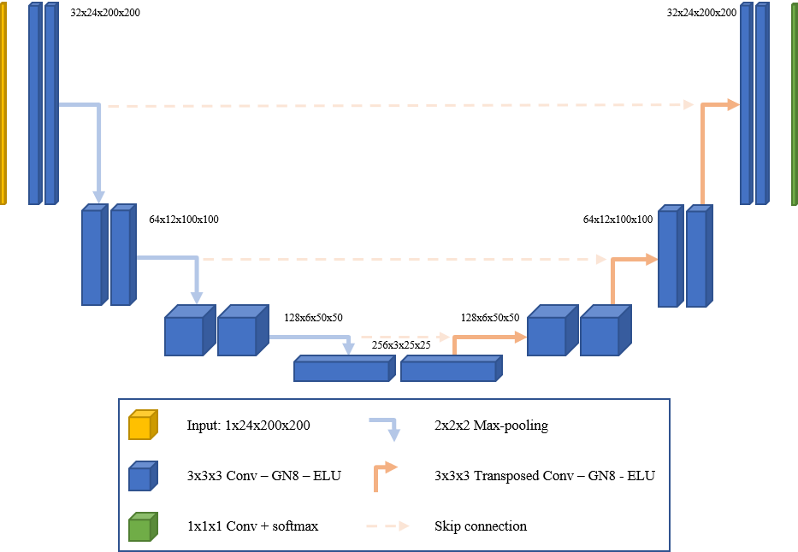
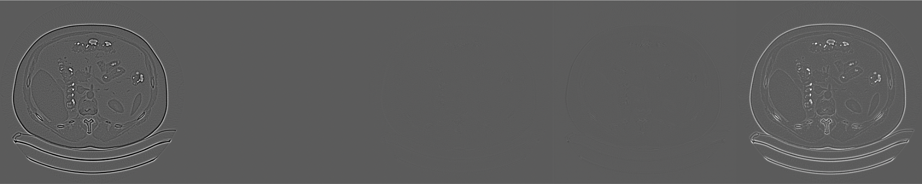
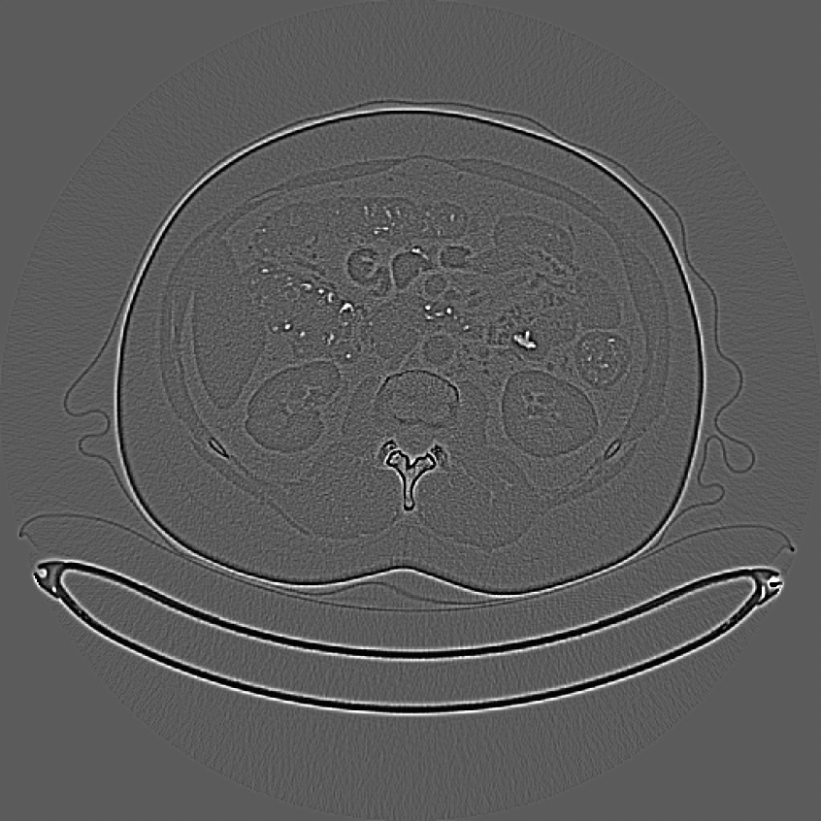

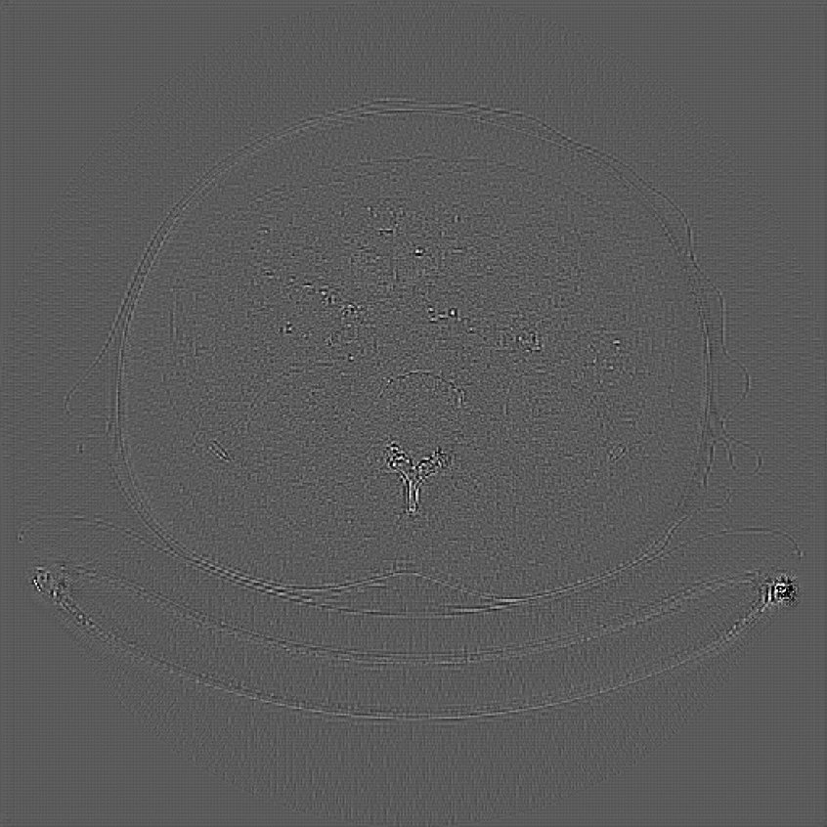
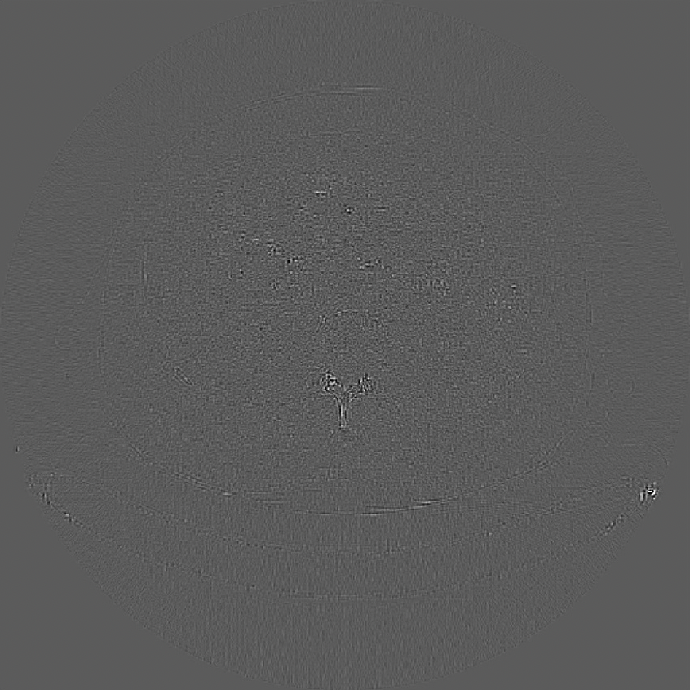
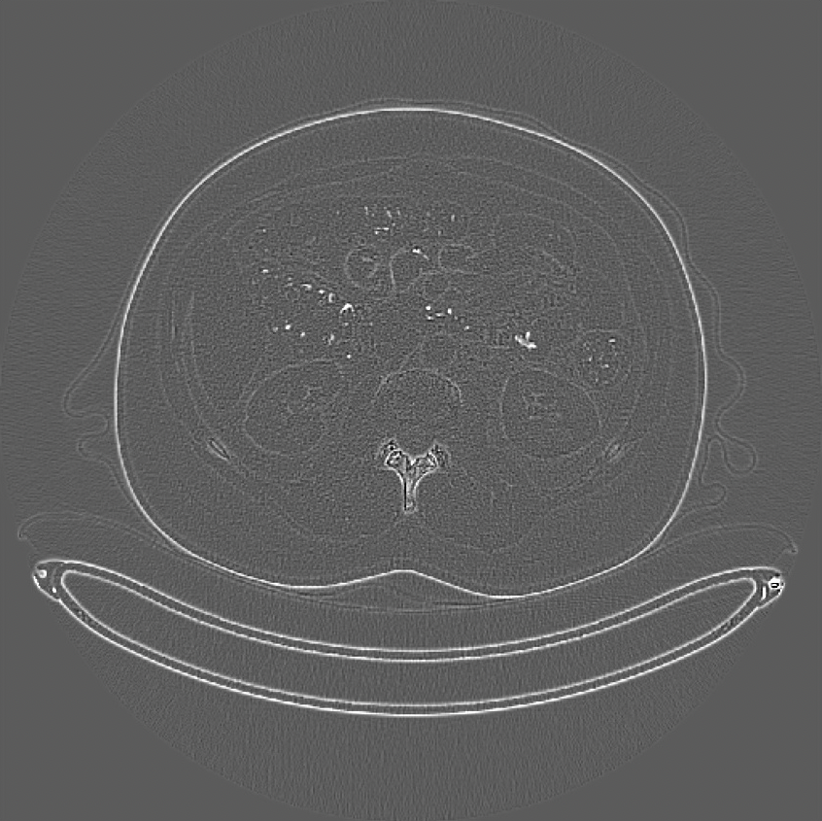
Solve Deblurring and Super Resolution in Low-dose Computed Tomography via One Novel Neural Network
Mingjun Feng, Nixa High School
♦ Introduction
♦ Model Structure
♦ Conclusion and future work
CT is a diagnostic imaging procedure that combines image formation using the interactions between X-rays and matter, data capture/conversion with high-end detector systems, and sophisticated algorithms to produce tomographic (cross sectional) images. More than 70 million CT scans are performed every year in the US alone, and 300 million CT scans worldwide[Hsieh, 2003].
Currently, CT-images mostly focuses on high dose, which produces clear images; however high dose CT scans often cause great and lasting pain to patients, i.e., DNA damage, Bone destruction, cause cancer.
Dense connection model is widely used in the CT tasks in recent years.
I trained the networks, including RDN, Sharp RDN, and Sharp U-net, by using data set from AAPM and TCIA.
Base on the PSNR, SSIM, and RMSE, the regular RDN performed the best on image deblurring.
when doing SR, based solely on PSNR and RMSE, the RDN did better than the other two, yet when based on SSIM, the result showed that the Sharp U-Net did the best.
In the future, I will conduct an experiment to determine the optimal number of RDBs for each of the tasks for CT medical images.
Furthermore, inspired by the SSIM value of the Sharp U-Net, I will also conduct an experiment of SR by combining Sharp U-net and RDN——that is, let the Sharp U-Net first up resolution then train the RDN to match the corresponding images.
I developed a CT transfer website, CTHub, which can help doctors and patients to increase the quality of CT images.
Fig 1.12 Model of RDN, consisting of multiple RDBs
Fig 1.1
One other interesting effect that I have discovered is that by mere sharpening, a simple operation just makes particular feature more evident, an image, it provides an effect similar to that of deblur.
Fig 1.2
Fig 1.10 A standard Dense Connection model
Table 1.11: PSNR/SSIM comparison on dense connection models (Dataset: Set5, Set14, and Urban100)
Residual Dense Network is designed specifically for image super resolution and has reached a SOTA. I will first apply RDN and revised RDN to simultaneously solve the deblurring and super resolution problems in CT images.
Fig 1.13 Sharp RDN, consisting of a Sharpen layer and RDBs
Since sharpen helps with deblur, I tried to add a sharpen layer[M. Nagare et al] to the model to see if it can solve both image super resolution and deblur effectively.
♦ Data & Experiment Setup
The simulation data set in this study was obtained from the AAPM DL-spectral CT challenge[Sidky and Pan, 2022]. The 512×512 pixel training images are from a breast phantom simulation, in total of 1000 cases. In totally of 80 subjects, 63 patient scans for training, 6 for validation, and 11 for testing.
Environment setting
Programming tools: Python / Tensorflow
Computational Resource: Nvidia K80 / T4, Storage 57G, Google Colab Pro+
♦ Achievement
Due to the U-net structure’s output size has to be the same as the input size, the training input is first down resolution then up resolution.
This research has been published on ACM conference and the source code are released on Github.
Fig 1.3
Fig 1.14
The clinical data set was obtained from the TCIA Pancreas-CT data[Roth et al., 2016]. The dataset includes 80 abdominal contrast-enhanced 3D CT scans from 53 male and 27 female subjects. The image size is 512 × 512. Total of 1230 images divided into three groups with 968 for training, 103 for validation, and 159 for testing.
Fig 1.3
Fig 1.15
♦ Results
Fig 1.4: Normal image
Fig 1.5: Blurred image
Fig 1.6: Low resolution image
AAPM
Deblur
Result
Blurred Groundtruth RDN Sharp RDN Sharp U-Net
AAPM
SR
Result
Downsampled Groundtruth RDN Sharp RDN Sharp U-Net
♦ Related Work:
♦ References
Conventional Methods
Deblurring: CT-machine has their own defect, different filters were needed for different machine and because it might also worn out, filters also have to be updated.
Super Resolution: interpolation would be used. However, because interpolation just takes the average, important information is often lost.
Deep Learning Methods
Deep learning methods consist convolutional kernels and each kernel learns certain features of an image. However, all of the network is design to solve a problem and therefore often fails on other tasks.
U-net
For example, U-net is one of the establish networks in the area of medical. The structure looks like a “U” since the information is press and fold back again.
[Hsieh, 2003] Hsieh, J. (2003). Computed tomography: principles, design, artifacts, and recent advances.
[Sidky and Pan, 2022] Sidky, E. Y. and Pan, X. (2022). Report on the aapm deep-learning sparse-view ct grand challenge. Medical Physics.
[Roth et al., 2016] Roth, H. R., Farag, A., Turkbey, E. B., Lu, L., Liu, J., and Summers, R. M. (2016). Data from pancreas-ct. The cancer imaging archive, 32.
Zhang, Y., Tian, Y., Kong, Y., Zhong, B., and Fu, Y. (2020).
Residual dense network for image restoration. IEEE Transactions on Pattern Analysis and Machine Intelligence, 43(7):2480–2495.
Al‐Ameen, Zohair, and Ghazali Sulong. "A novel Zohair filter for deblurring computed tomography medical images." International Journal of Imaging Systems and Technology 25.3 (2015): 265-275.
Meijering, Erik HW, Wiro J. Niessen, and Max A. Viergever. "Quantitative evaluation of convolution-based methods for medical image interpolation." Medical image analysis 5.2 (2001): 111-126.
M. Nagare et al., "A Noise Preserving Sharpening Filter for CT Image Enhancement," 2022 IEEE International Conference on Image Processing (ICIP), Bordeaux, France, 2022, pp. 2566-2570, doi: 10.1109/ICIP46576.2022.9897227.
Fig 1.1, 1.2,1.4, 1.14: TCIA dataset
Fig 1.13: AAPM dataset
Fig 1.3, 1.5, 1.6, 1.13, 1.17, 1.18, 1.19, 1.20: Student created
Fig 1.7: https://www.geog.leeds.ac.uk/groups/geocomp/1999/082/gc_082.htm
Fig 1.8: Regression Analysis using Deep Learning
Fig 1.9: https://towardsdatascience.com/creating-and-training-a-u-net-model-with-pytorch-for-2d-3d-semantic-segmentation-model-building-6ab09d6a0862.
Fig 1.10 and 1.11: Li, Juncheng, Zehua Pei, and Tieyong Zeng. "From beginner to master: A survey for deep learning-based single-image super-resolution." arXiv preprint arXiv:2109.14335 (2021).
Fig 1.12: Zhang, Y., Tian, Y., Kong, Y., Zhong, B., and Fu, Y. (2020).
Residual dense network for image restoration. IEEE Transactions on Pattern Analysis and Machine Intelligence, 43(7):2480–2495.
Fig 1.17
Blurred Groundtruth RDN Sharp RDN Sharp U-Net
-Groundtruth -Groundtruth -Groundtruth -Groundtruth -Groundtruth
Fig 1.18
Downsampled Groundtruth RDN Sharp RDN Sharp U-Net
-Groundtruth -Groundtruth -Groundtruth -Groundtruth -Groundtruth
Fig 1.7
 | Blurred | RDN | Sharp RDN | Sharp U-Net
PSNR | 27.34 | 48.86 | 48.45 | 30.12
SSIM | 0.61 | 0.99 | 0.99 | 0.73
RMSE | 0.0431 | 0.0036 | 0.0038 | 0.0312
 | Downsampled | RDN | Sharp RDN | Sharp U-Net
PSNR | 23.65 | 26.49 | 26.35 | 22.84
SSIM | 0.79 | 0.8 | 0.81 | 0.76
RMSE | 0.0609 | 0.0382 | 0.0385 | 0.042
TCIA
Deblur
Result
Blurred Groundtruth RDN Sharp RDN Sharp U-Net
TCIA SR
Result
Downsampled Groundtruth RDN Sharp RDN Sharp U-Net
Fig 1.8
Fig 1.9
Fig 1.19
Blurred Groundtruth RDN Sharp RDN Sharp U-Net
-Groundtruth -Groundtruth -Groundtruth -Groundtruth -Groundtruth
Fig 1.20
Downsampled Groundtruth RDN Sharp RDN Sharp U-Net
-Groundtruth -Groundtruth -Groundtruth -Groundtruth -Groundtruth
Motivation: I want to improve the quality of low-dose CT images by using one AI neural network. Our technology can provide high quality medical images for doctors and reduces the risk for patients.
 | Blurred | RDN | Sharp RDN | Sharp U-net
PSNR | 13.14 | 37.24 | 36.1 | 21.56
SSIM | 0.92 | 0.99 | 0.99 | 0.96
RMSE | 50.48 | 10.85 | 11.78 | 33.11
 | Downsampled | RDN | Sharp RDN | Sharp U-Net
PSNR | 37.219 | 48.667 | 42.791 | 40.329
SSIM | 0.44 | 0.538 | 0.407 | 0.586
RMSE | 42.927 | 11.837 | 23.7 | 30.126

